Slide 1

UNIVERSITY INSTITUTEOF ENGINEERING
Bachelor of Engineering (Computer Science & Engineering)
Operating System (20CST/ITT-313)
Subject Coordinator: Er. Puneet Kaur(E6913)
Introduction to Operating System
DISCOVER . LEARN . EMPOWER
Font size 24

Slide 2
System Protection and Security
.

Slide 3
The Security Problem
System secure if resources used and accessed as intended under all circumstances
Unachievable
Intruders (crackers) attempt to breach security
Threat is potential security violation
Attack is attempt to breach security
Attack can be accidental or malicious
Easier to protect against accidental than malicious misuse

Slide 4
Security Violation Categories
Breach of confidentiality
Unauthorized reading of data
Breach of integrity
Unauthorized modification of data
Breach of availability
Unauthorized destruction of data
Theft of service
Unauthorized use of resources
Denial of service (DOS)
Prevention of legitimate use

Slide 5
Security Violation Methods
Masquerading (breach authentication)
Pretending to be an authorized user to escalate privileges
Replay attack
As is or with message modification
Man-in-the-middle attack
Intruder sits in data flow, masquerading as sender to receiver and vice versa
Session hijacking
Intercept an already-established session to bypass authentication

Slide 6
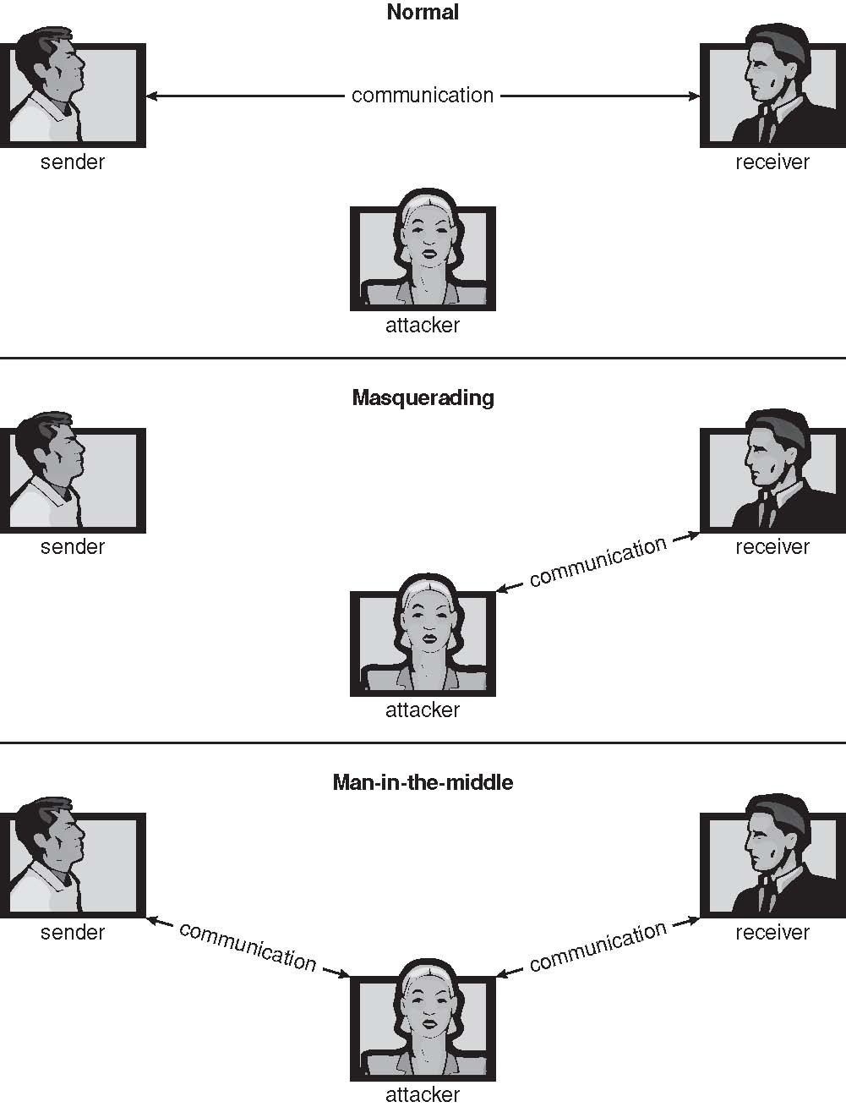
Standard Security Attacks

Slide 7
Security Measure Levels
Impossible to have absolute security, but make cost to perpetrator sufficiently high to deter most intruders
Security must occur at four levels to be effective:
Physical
Data centers, servers, connected terminals
Human
Avoid social engineering, phishing, dumpster diving
Operating System
Protection mechanisms, debugging
Network
Intercepted communications, interruption, DOS
Security is as weak as the weakest link in the chain
But can too much security be a problem?

Slide 8
Program Threats
Many variations, many names
Trojan Horse
Code segment that misuses its environment
Exploits mechanisms for allowing programs written by users to be executed by other users
Spyware, pop-up browser windows, covert channels
Up to 80% of spam delivered by spyware-infected systems
Trap Door
Specific user identifier or password that circumvents normal security procedures
Could be included in a compiler
How to detect them?

Slide 9
Program Threats (Cont.)
Logic Bomb
Program that initiates a security incident under certain circumstances
Stack and Buffer Overflow
Exploits a bug in a program (overflow either the stack or memory buffers)
Failure to check bounds on inputs, arguments
Write past arguments on the stack into the return address on stack
When routine returns from call, returns to hacked address
Pointed to code loaded onto stack that executes malicious code
Unauthorized user or privilege escalation

Slide 10
Program Threats (Cont.)
Viruses
Code fragment embedded in legitimate program
Self-replicating, designed to infect other computers
Very specific to CPU architecture, operating system, applications
Usually borne via email or as a macro
Visual Basic Macro to reformat hard drive
Sub AutoOpen()
Dim oFS
Set oFS = CreateObject(’’Scripting.FileSystemObject’’)
vs = Shell(’’c:command.com /k format c:’’,vbHide)
End Sub

Slide 11
Program Threats (Cont.)
Virus dropper inserts virus onto the system
Many categories of viruses, literally many thousands of viruses
File / parasitic
Boot / memory
Macro
Source code
Polymorphic to avoid having a virus signature
Encrypted
Stealth
Tunneling
Multipartite
Armored

Slide 12
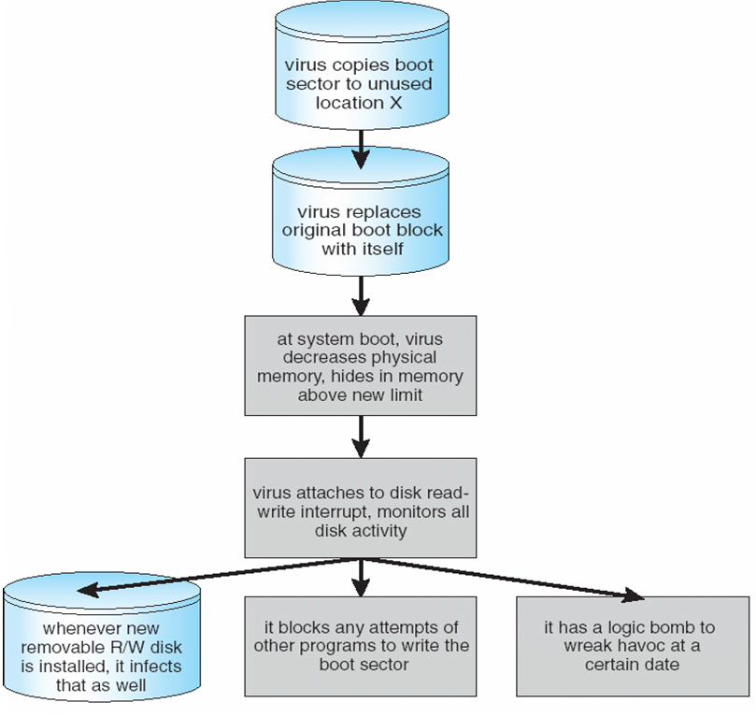
A Boot-sector Computer Virus

Slide 13
The Threats Cont…
Attacks are still common, still occurring
Attacks moved over time from science experiments to tools of organized crime
Targeting specific companies
Creating botnets to use as tool for spam and DDOS delivery
Keystroke logger to grab passwords, credit card numbers
Why is Windows the target for most attacks?
Most common
Everyone is an administrator
Licensing required?
Monoculture considered harmful

Slide 14
System and Network Threats
Some systems “open” rather than secure by default
Reduce attack surface
But harder to use, more knowledge needed to administer
Network threats harder to detect, prevent
Protection systems weaker
More difficult to have a shared secret on which to base access
No physical limits once system attached to internet
Or on network with system attached to internet
Even determining location of connecting system difficult
IP address is only knowledge

Slide 15
System and Network Threats (Cont.)
Worms – use spawn mechanism; standalone program
Internet worm
Exploited UNIX networking features (remote access) and bugs in finger and sendmail programs
Exploited trust-relationship mechanism used by rsh to access friendly systems without use of password
Grappling hook program uploaded main worm program
99 lines of C code
Hooked system then uploaded main code, tried to attack connected systems
Also tried to break into other users accounts on local system via password guessing
If target system already infected, abort, except for every 7th time

Slide 16
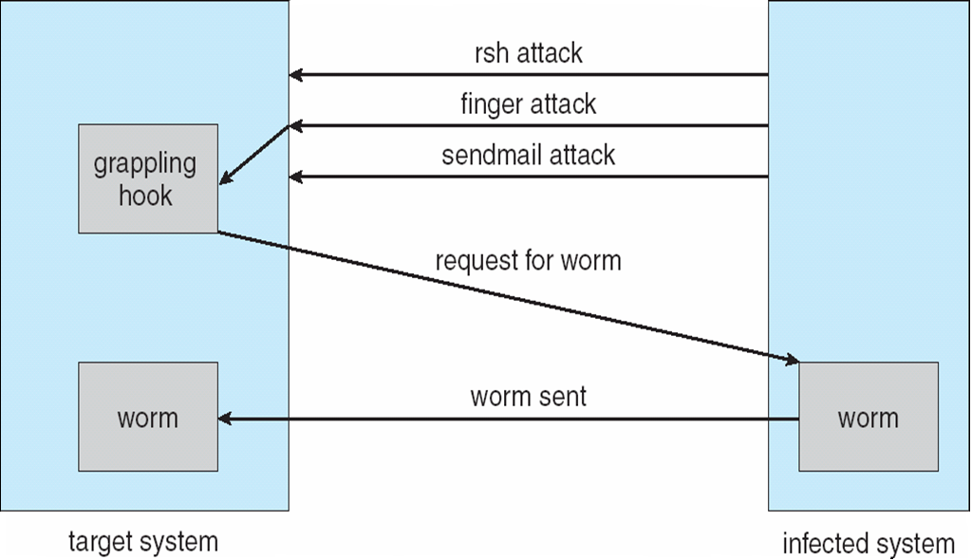
The Morris Internet Worm

Slide 17
System and Network Threats (Cont.)
Port scanning
Automated attempt to connect to a range of ports on one or a range of IP addresses
Detection of answering service protocol
Detection of OS and version running on system
nmap scans all ports in a given IP range for a response
nessus has a database of protocols and bugs (and exploits) to apply against a system
Frequently launched from zombie systems
To decrease trace-ability

Slide 18
System and Network Threats (Cont.)
Denial of Service
Overload the targeted computer preventing it from doing any useful work
Distributed denial-of-service (DDOS) come from multiple sites at once
Consider the start of the IP-connection handshake (SYN)
How many started-connections can the OS handle?
Consider traffic to a web site
How can you tell the difference between being a target and being really popular?
Accidental – CS students writing bad fork() code
Purposeful – extortion, punishment

Slide 19
Video Links
https://www.coursera.org/lecture/cyber-threats-attack-vectors/operating-systems-BZcHK https://www.youtube.com/watch?v=f5v9fdcRe_E

Slide 20
References
https://www.unf.edu/public/cop4610/ree/Notes/PPT/PPT8E/CH15-OS8e.pdf
https://www.tutorialspoint.com/operating_system/os_security.htm
https://www.coursehero.com/file/19323929/Operating-System-Threats-and-Vulnerabilities/
https://www.cs.uic.edu/~jbell/CourseNotes/OperatingSystems/15_Security.html
https://devqa.io/security-threats-attack-vectors/
https://www.geeksforgeeks.org/system-security/
https://www.javatpoint.com/os-security-management

